Slide 1
Tumblr Take Home Test
User Registration Data Analysis

Slide 2
Datasets Involved
User Registration Data
Data that contains users who have registered on the tumblr on September 1st, and September 2nd, 2015
User Account Data
Table of accounts that were active on the 8th and 9th of September

Slide 3
Contents
Insights In User Registration
Device Insights
Registration Insights
Usage Statistics
Insights from User Account data
Key Insights

Slide 4
Insights In User Registration

Slide 5
Insights by Country
Country | Count
United States | 4483
Great Britain | 784
Brazil | 767
Turkey | 663
Republic of Korea | 472
Italy | 431
Germany | 420
Mexico | 364
Canada | 358
Indonesia | 330
The United States of America is the country with the highest number of users with 4483 of users in the registration data.

Slide 6
Insights by Country
Country | Proportion
United States | 31.6%
Great Britain | 5.52%
Brazil | 5.40%
Turkey | 4.67%
Republic of Korea | 3.32%
Italy | 3.04%
Germany | 2.96%
Mexico | 2.56%
Canada | 2.52%
Indonesia | 2.32%
In fact, usage by Americans massively outpace other countries, with a 26.08% lead on second place.

Slide 7
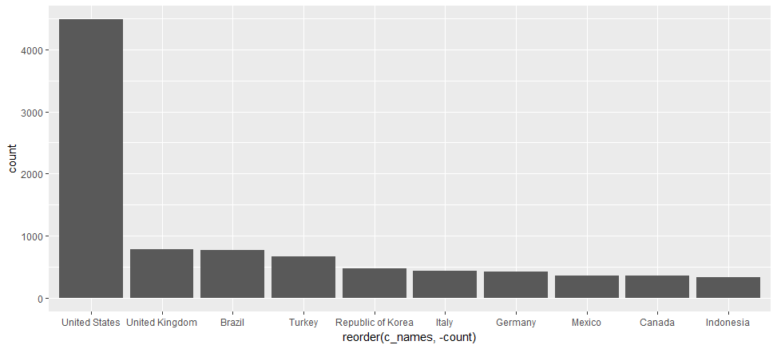
Insights by Country

Slide 8
Device Insights

Slide 9
Device Insights
Device | Count
Web | 5662
Android | 5091
Iphone | 3310
Api | 132
Yahoo_hnv | 2

Slide 10
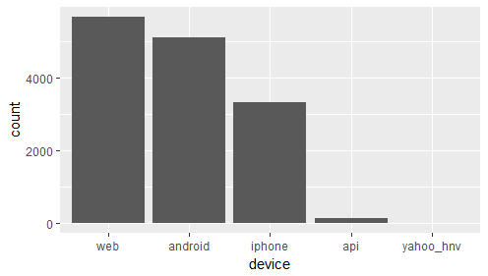
Bar Chart of Worldwide device Numbers
Web registrations are the leading source of registrations in the world, followed by android, and the iphone.
Counts for api and yahoo_hnv are negligable

Slide 11
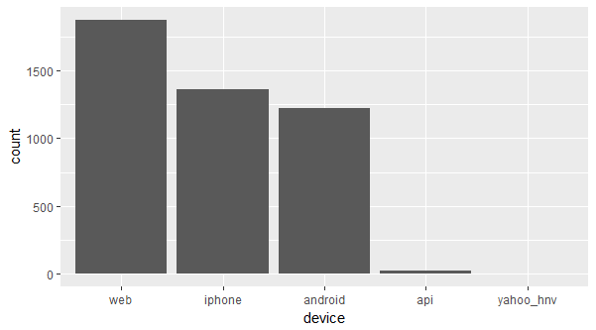
Bar Chart of US Device Numbers
The web leads registrations
The iphone has higher device usage for registration than android
Mobile devices have higher registration numbers than web registrations!

Slide 12
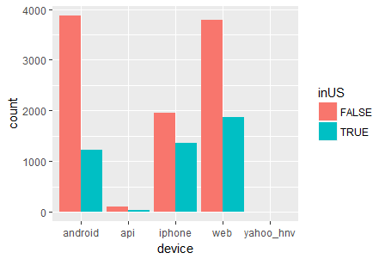
U.S. vs the World
Countries outside of the US have higher rates of registration for Android phones - 76% android usage
The US registered with a disproportionately higher amount of iphones with 41% of worldwide iphone registrations.
The US loves iphones!

Slide 13
Registration Insights

Slide 14
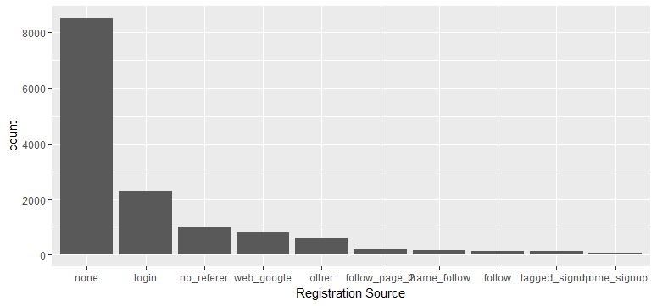
Registration Sources
None dominates the worldwide counts for registration source
This validates our earlier statement that most registrations came from mobile devices

Slide 15
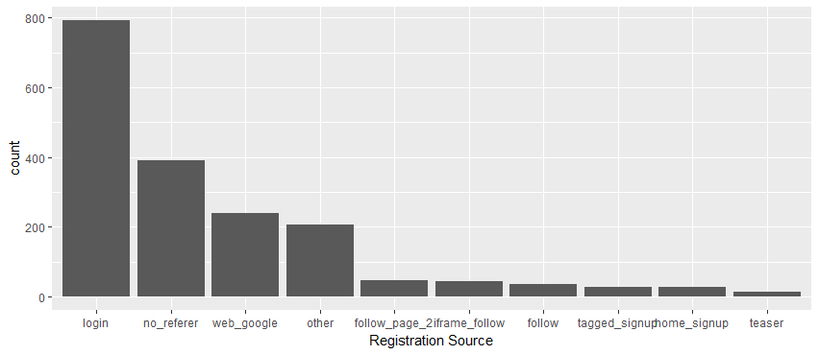
Registration Sources
Removing the “none” variable, web sources mostly came from
Logins
No referrals
Google
Interestingly enough, new users came of their own accord, some even getting there through web search

Slide 16
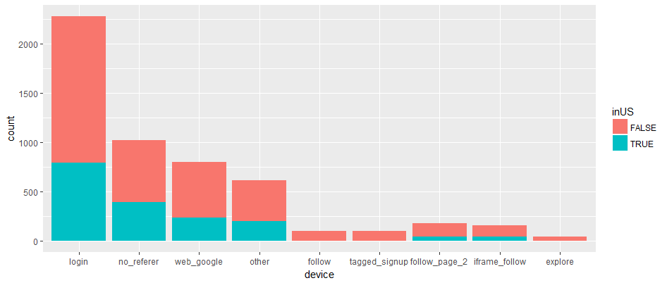
Registration Sources – US. Vs theWorld
Proportions held steady across web sources.
Web registration patters remained consistent inside and outside of the US
Remains consistent with out earlier observation of consistency in US. Vs World slide for Device registration (except for the iphone)

Slide 17
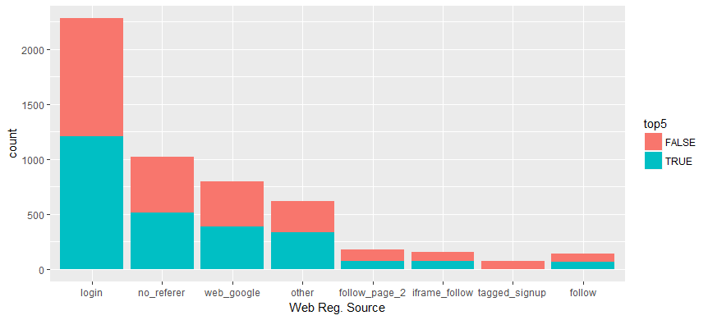
Top 5 Countries VS Rest of Word
Top 5 Countries include the US, Great Britain, Brazil, Turkey, and Republic of Korea
No real change in most vs least populous countries – they registered in similar ways

Slide 18
Usage Insights

Slide 19
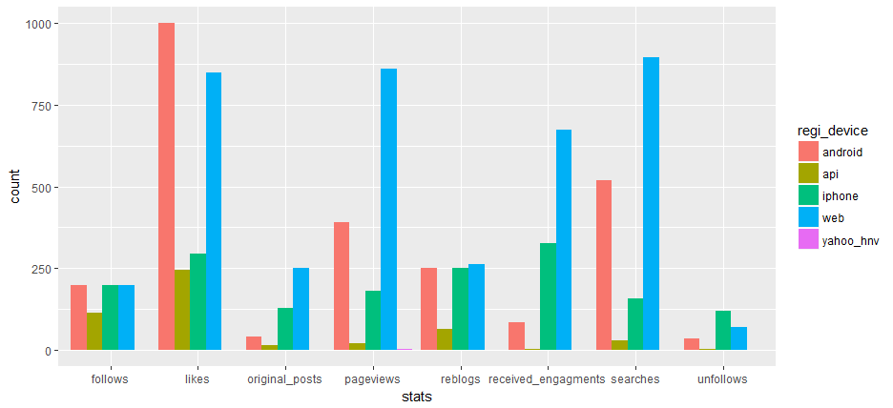
Worldwide Usage Stats – Split by Device
This is where things get interesting:
Overall, devices registered by web have the highest engagement numbers in the first 24 hours
Android users have the highest numbers of likes – given its popularity internationally, can this possible correlate with how foreigners use tumblr?
Besides likes, it’s interesting the difference between web and mobile use
Android users outpaced iphone users in likes, pageviews, and searches. Do they use tumblr superficially?

Slide 20
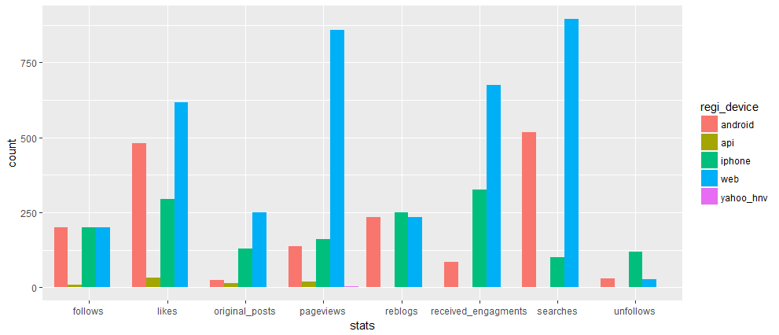
Usage Metrics – United States
True to device registrations, web registrations had the highest counts for use.
Iphone users won out in original posts, pageviews, reblogs, and receieved engagements
Amongst mobile, iphones users seemed produce more content. Android users mostly browsed content

Slide 21
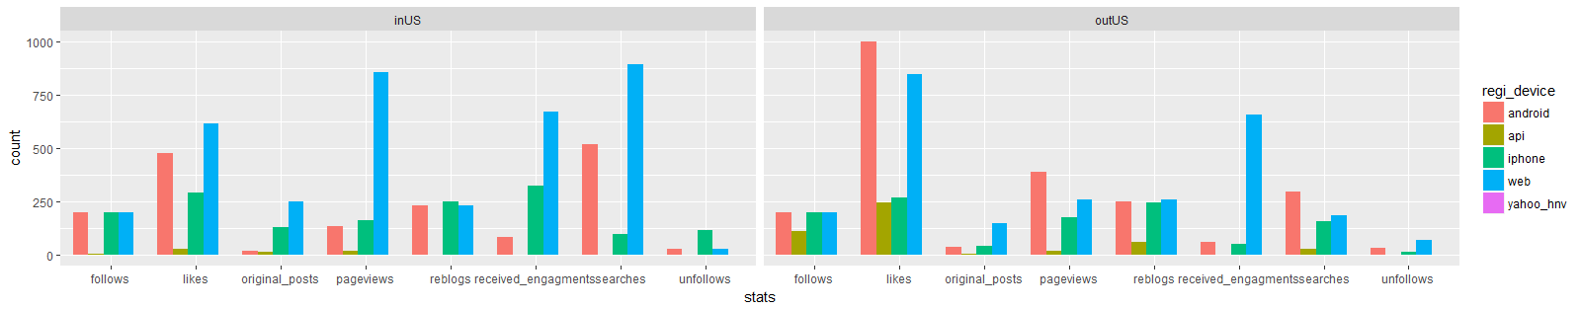
In vs outside the US: tumblr usage split by device

Slide 22
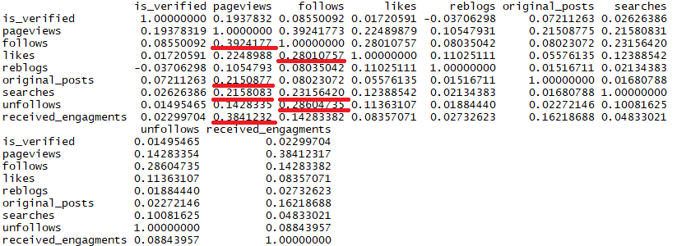
Correlation plot of Usage
This measures of tied variables are to each other
The higher the number, the more tied they are, with a max of one.
Pageviews has the highest correlation numbers – which makes sense. It was a favorite activity among new users.

Slide 23
Usage Insights
Agreeing with earlier charts, android use is prevalent with people outside of the US
Non Americans prefer to like and search, with users liking more than twice as much as pageviews and searches. Most engagements happened over the web.
Android users in the US have more follows, likes, and searches than iphone users, despite the fact that more americans registered with iphones than android phones. Android users only seemed to browse and like, while iphone users provided more content. Could there be a correlation between people who like iphones and people who engage meaningfully on the platform?

Slide 24
Insights From User Account Data

Slide 25
Working with User Account Data
User accounts is a data set that logged active users on September 8th and 9th, 2015
Analysis was done to see which users remained and why

Slide 26
Working with User Account Data
No. of active accounts: 5655
No. of accounts registered: 14197
Percentage retained: 39.8 %
Why?

Slide 27
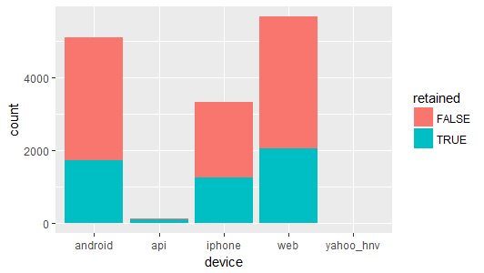
Was it device registration?
Does not seem so. The proportion of retained users seems constant across devices.
The type of device registered did not determine if users stayed or not

Slide 28
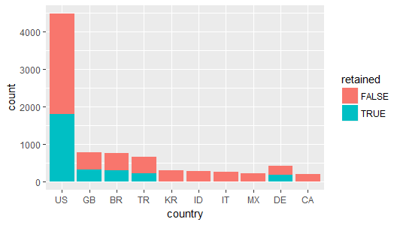
Top Countries retained vs unretained users
Countries with the largest proportion of registered users tended to have higher rates of retention.
Countries with less users tended to wash out of the service.
Perhaps this means countries with larger populations should be targeted.

Slide 29
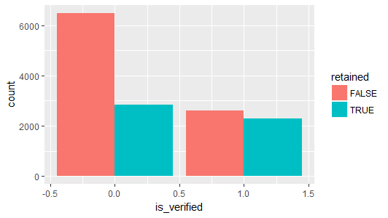
Is verfied
A higher proportion of users who verified their email address still kept using the service despite low retention.

Slide 30
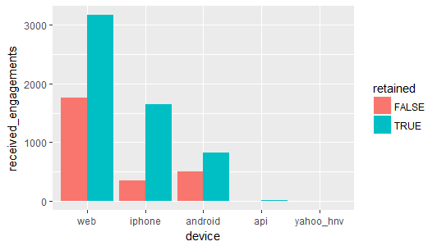
Received Engagements
As differences between retained and unretained users were explored
Users who produced more had higher levels of retention – received engagement tends to correlate with original

Slide 31
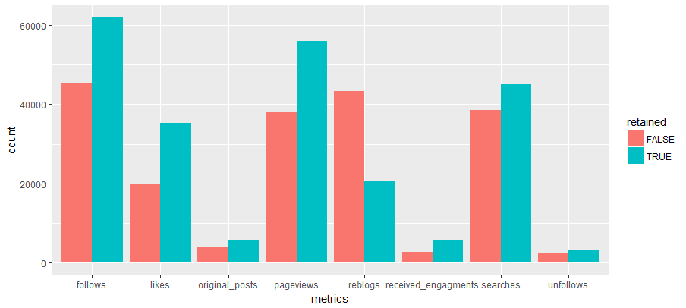
Use Metrics
Despite making up approx. 39% of registered users, retained users outpaced non-retained users in all areas except for reblogs
Reblogging did not determine whether a user will stay or not

Slide 32
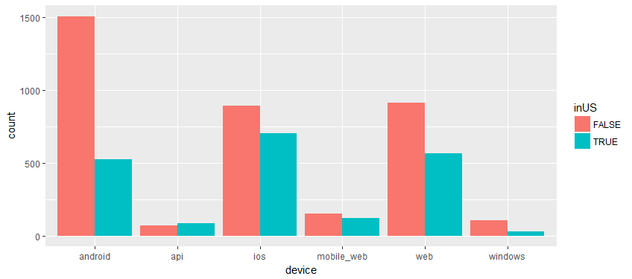
Retained Device Types
Android takes the lead for having the most retained users internationally.
IOS takes the lead of having the most retained users in the US
This contrasts with web having the highest number of registrations.
Could users have switched devices?
Who switched the most?

Slide 33
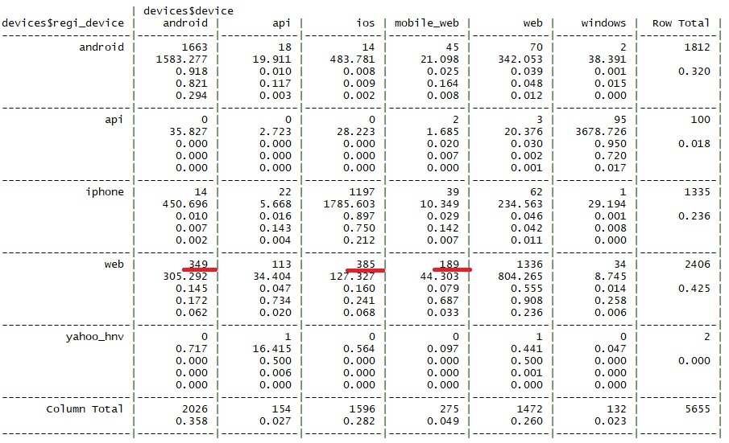
Registered Vs Active Devices
As it turns out our hypothesis was correct!
There was conversion from users who registered via the web.

Slide 34
Registered Vs Active Devices 2
A total of 1070 users switched from web registrations
The majority of these switched to mobile platforms and were led by:
IOS
Android
Mobile_web – (probably a browser)
Their habits changed!

Slide 35
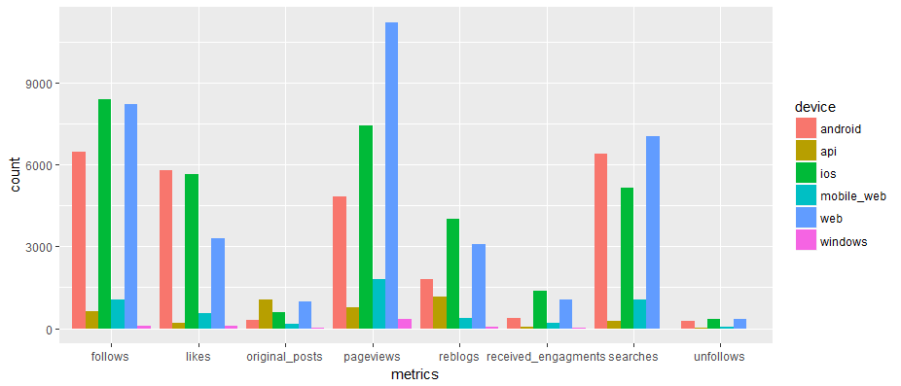
Usage metrics among retained users (US)
True to form, the Iphone keeps pace with and even outclasses web use
Most users used the platform to browse content

Slide 36
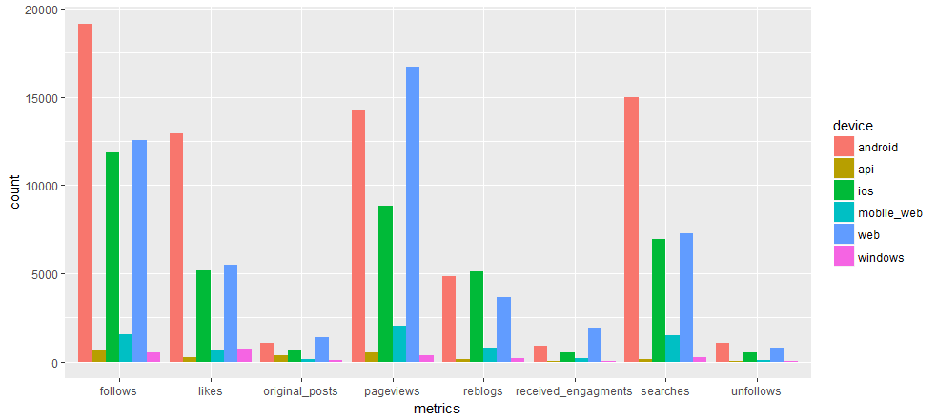
Usage Metrics for retained users (~US)
Android has high numbers as expected
Iphone also has high numbers as well
Due to web users converting to mobile

Slide 37
Key Insights
What we learned about the data
The US outpaces the world in initial platform use and registration
A lot of them use Iphones – disproportionately so.
Users generally consumed content instead of engaging with it
Viewing pages and following had the highest correlations with other activities on the site
The web is important for signing up new users:
They are willing to convert to mobile platforms if they like the serivce
Rentention seems to be correlated with
Size of Country User registered
Use of the platform within the first 24 hours – higher passive use of content led to more retention.

Slide 38
Key Insights
Users that stayed with the service
Switched from Web to Mobile platforms
Spent most of their time passively browsing and liking content

Slide 39
Conclusion
Web Registration is very Important.
While most users registered via mobile devices, a sizable portion still registered via the web.
A lot of first impressions happen on the tumblr’s web service.
They then tended to switch to mobile if they liked the service.
Keep iphone users happy.
The US has the largest share of registered users, and a disproportionate number of them use iphones. Web users converted to iphones in surprisingly high numbers, worldwide. A good iphone product will service a large base.
Keep them browsing.
The correlation matrix showed that the highest correlations occurred with pageviews, followed by follows. The more they browse, the more likely they are to use other features, and the more likely they are to keep using tumblr.

Slide 40
Conclusion
The android experience extremely important for the international Market.
High numbers for registration
High numbers of web users converted if they liked the service

Slide 41
Thanks!

